Slide 1

Hand Gesture Game Controller Using Arduino

Slide 2

MD. AZIZ MIA
ID: 1521739042
SAKIF AHMMED
ID: 16103210142
MD. TANVIR HASSAN BHUIYAN
ID: 1610930042
MD. SIAM
ID: 1612544042
Prepared by

Slide 3
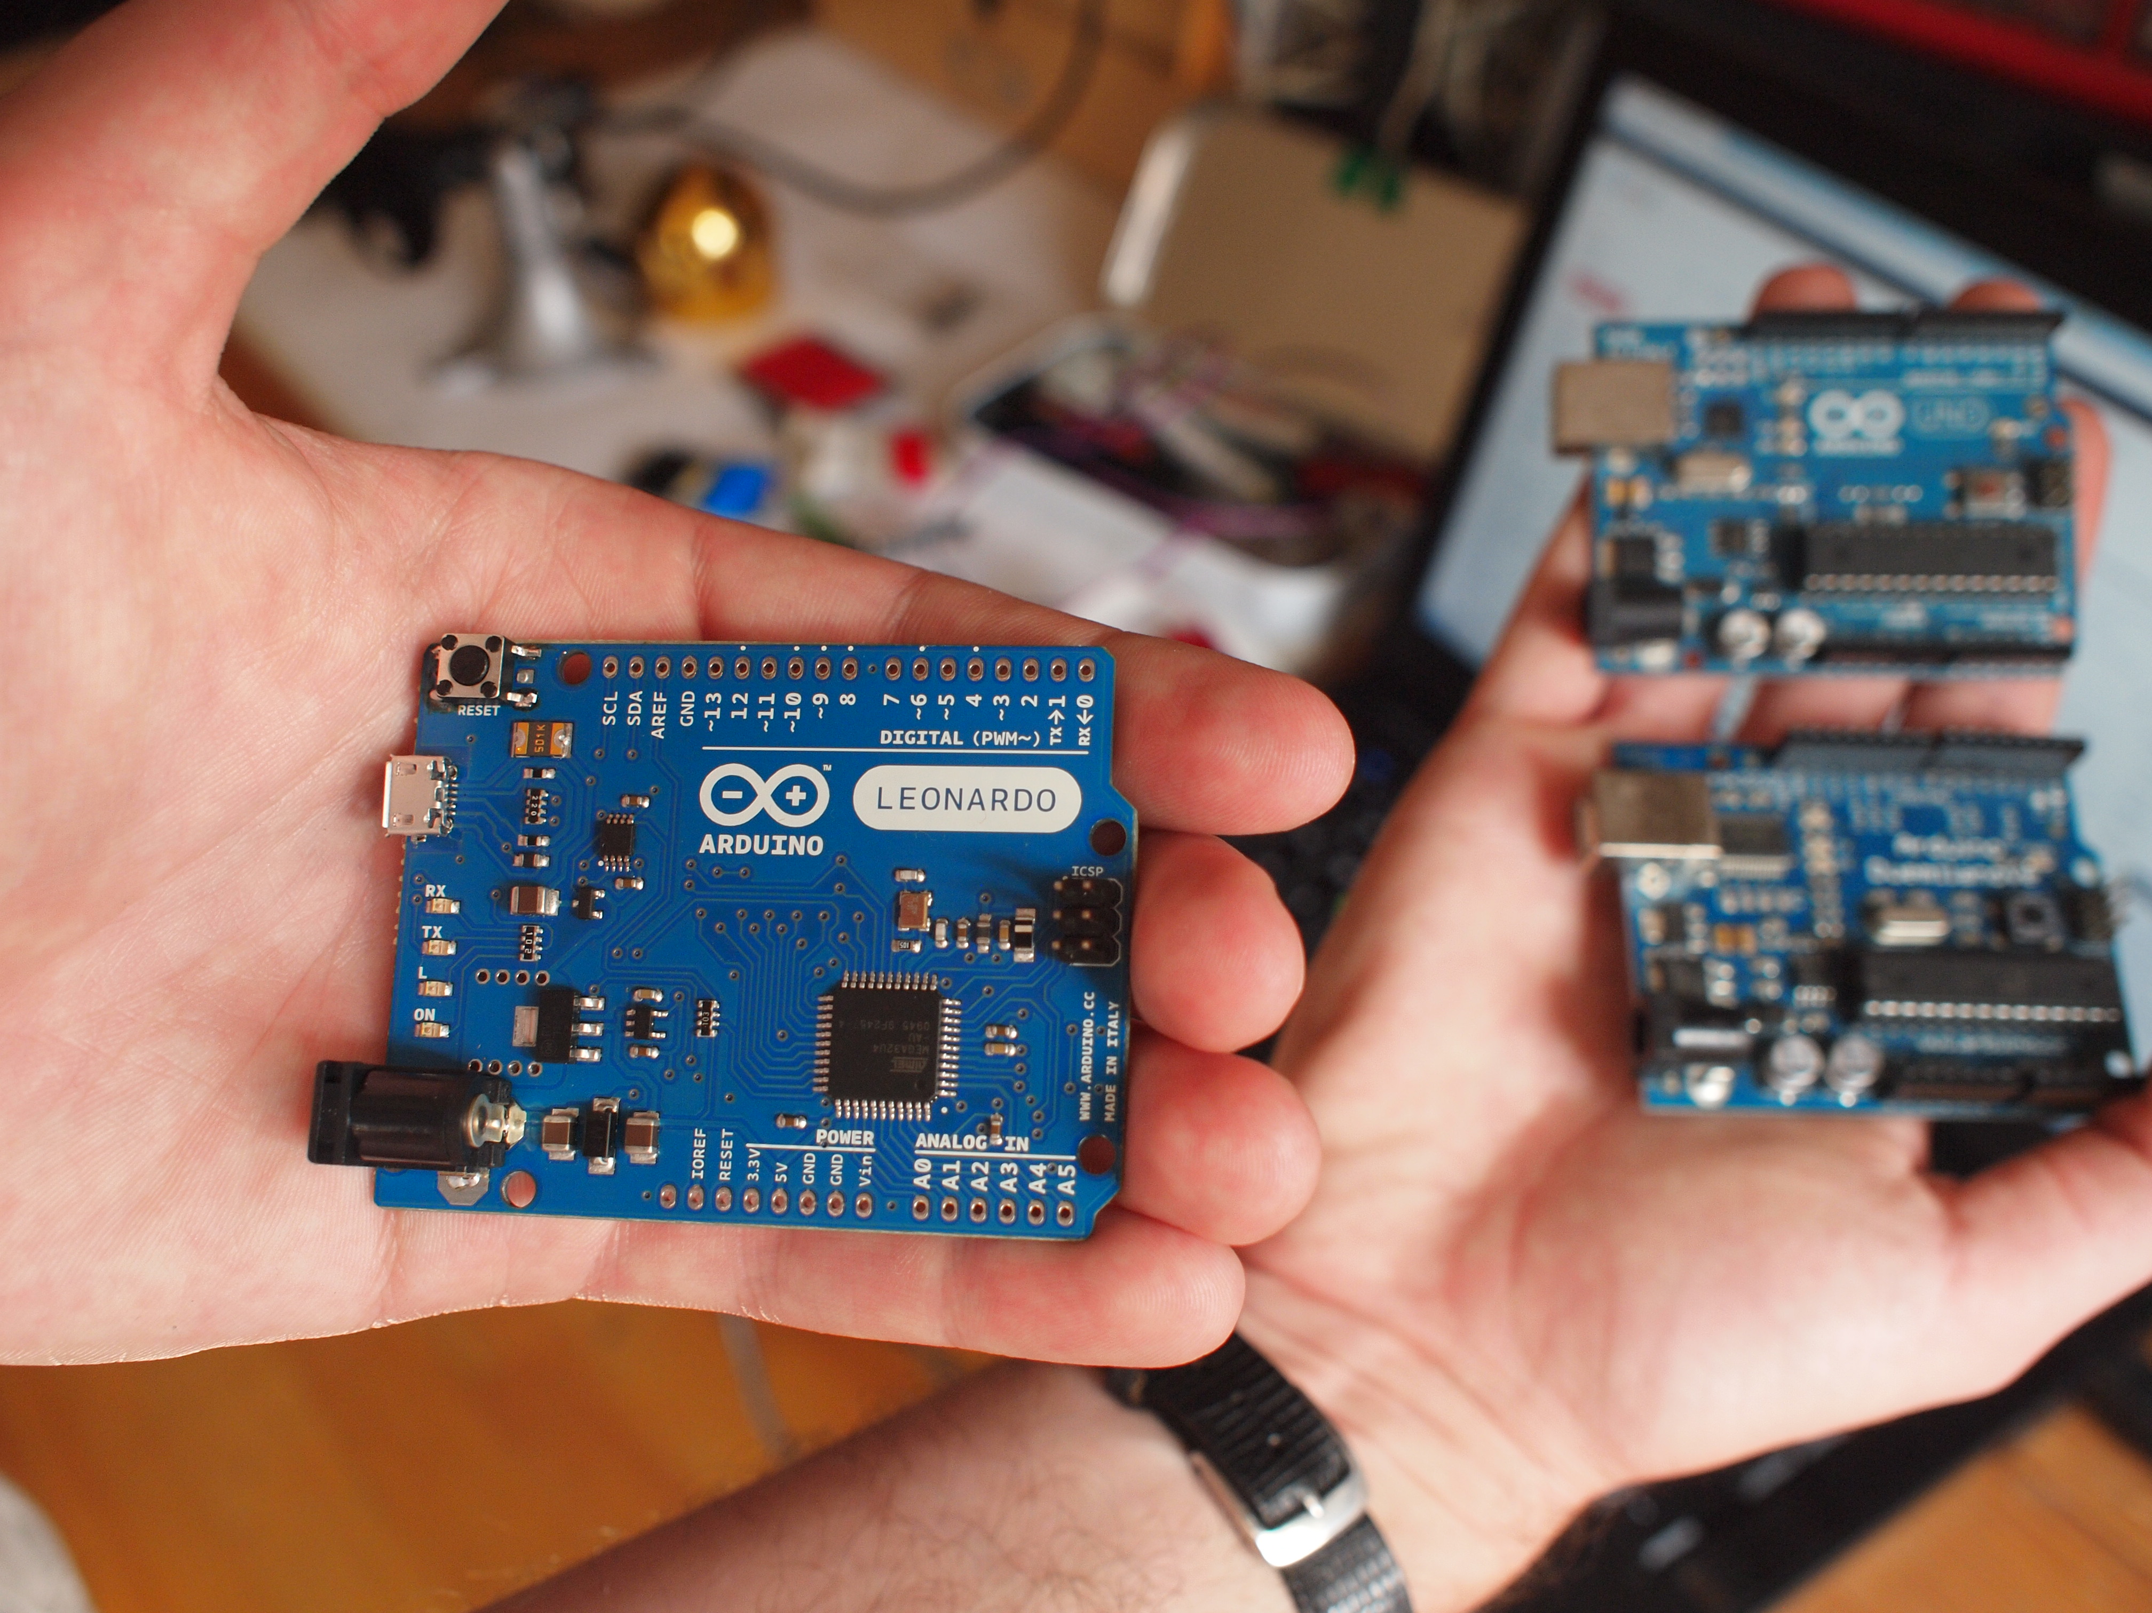
Introduction
In this project we are going to make a hand gesture control device using Arduino Leonardo and some other sensors. By completing this project we will be able to control the games of our PC. This gesture control will just be a crack on the endless possibilities of gesture control.

Slide 4
Card Board
Bread Board
Jumper Wires (M to M -&- M to F)
Equipments
IR Obstacle Avoidance Sensor
Arduino Leonardo

Slide 5
Process
We will be using Arduino keyboard library to convert the inputs from IR obstacle sensor to key strokes for controlling the car in NFS game.
Using sensors to control the up key, down key, right key and left key. We’ll set the sensors in four corners of the Arduino Leonardo Board as we’ve planned. These four sensors will work like the four keys.
Sensors will help us to use our hands to work same as the typical game controllers and keyboard keys. The sensors will be connected in the Arduino. The Arduino will be connected to a PC with an Arduino USB connector.

Slide 6
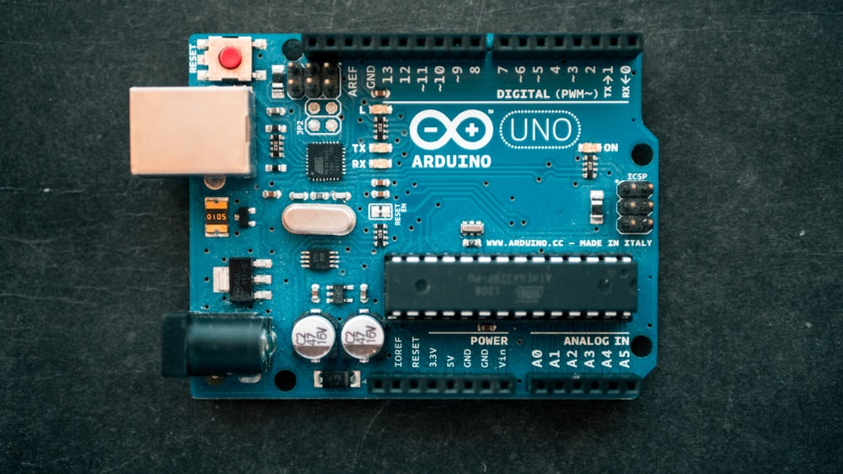
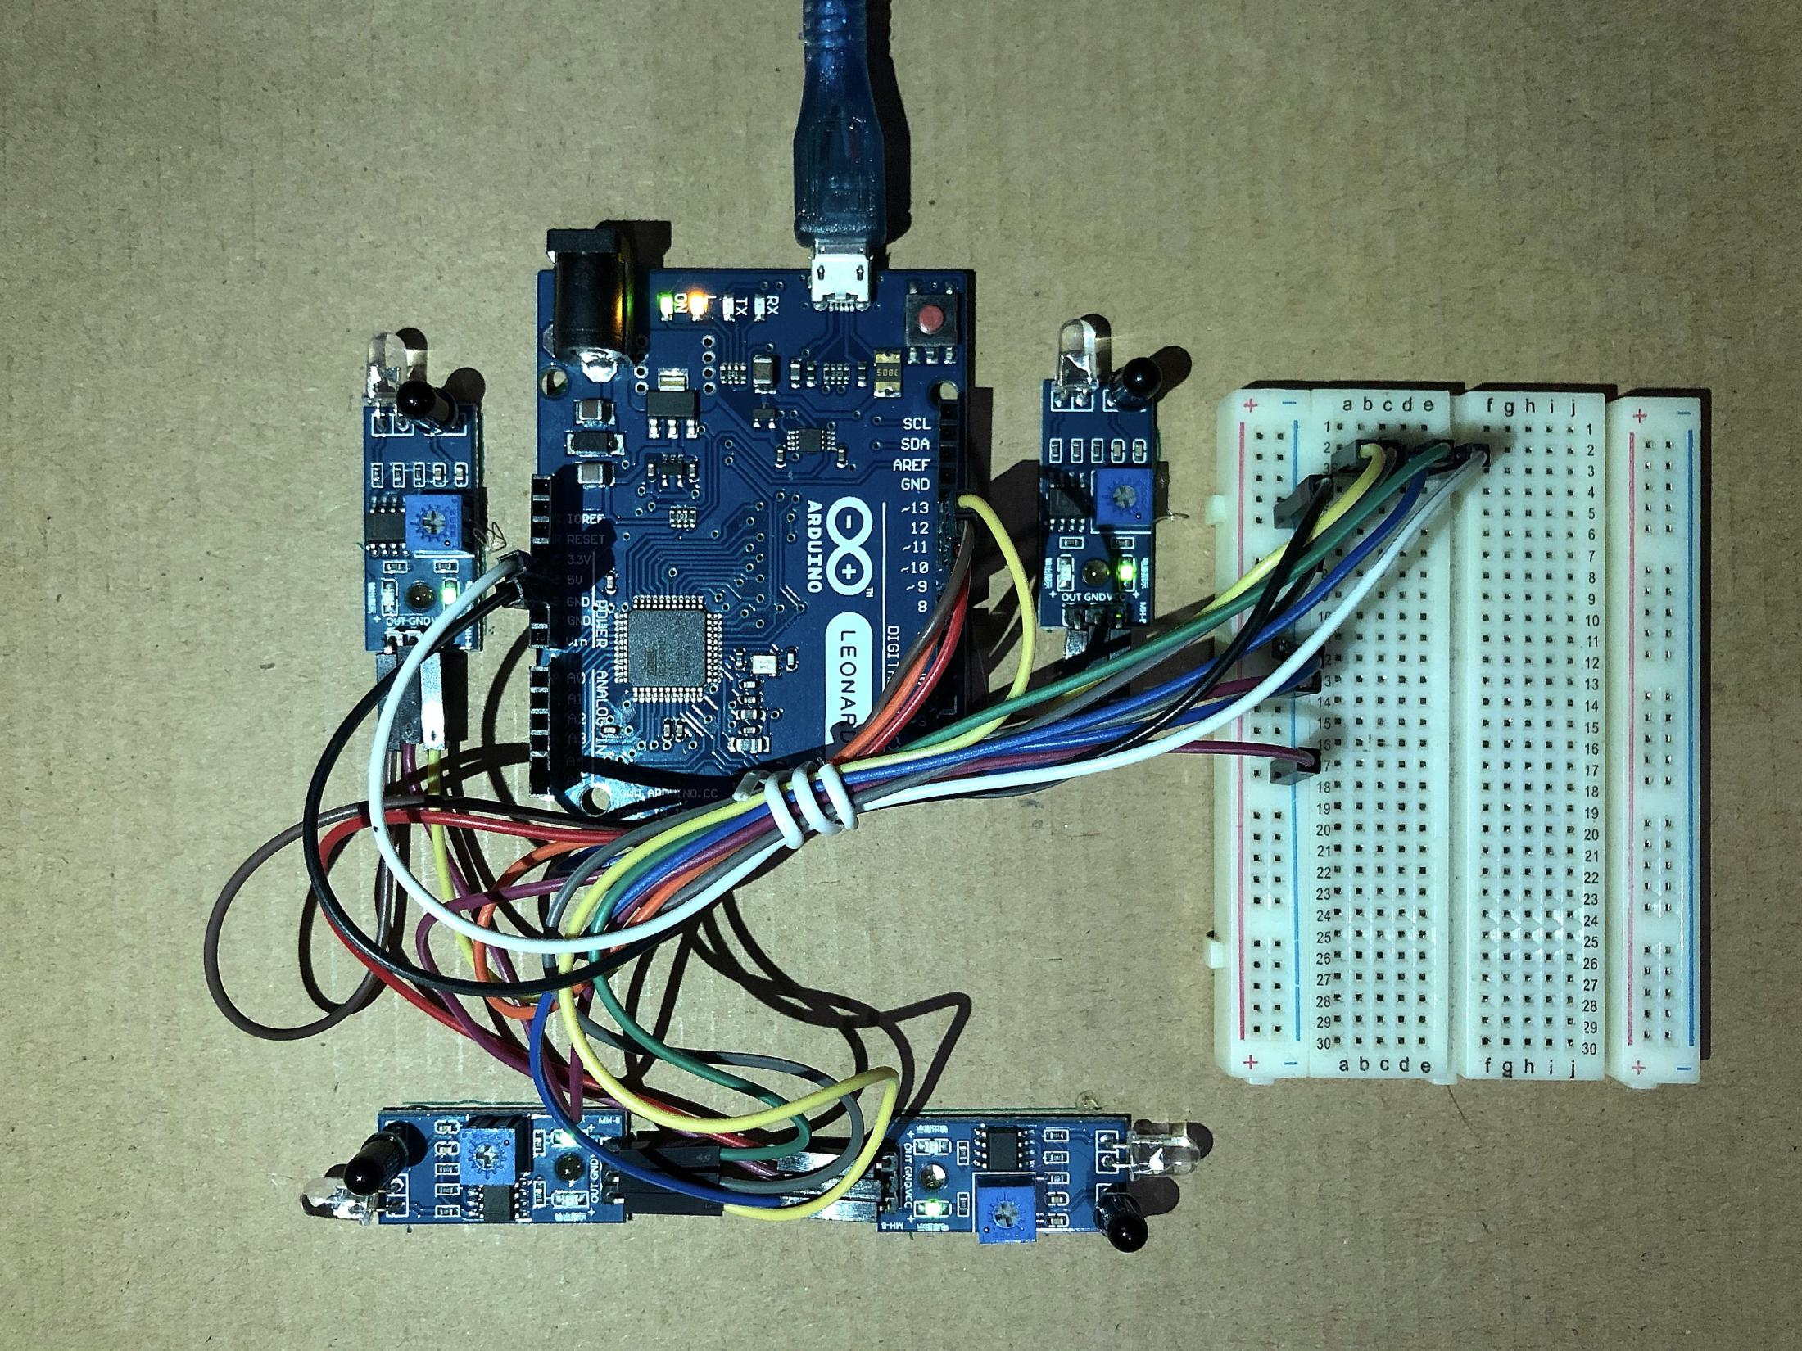
Hardware Implementation

Slide 7
Project Goal
Project goal is to develop a wireless game controller using Arduino. By completing this project we’ll be able to control our game by using our bare hands. There will be no need of any using of fingers like the typical game controller. There might be people who may have problems with their fingers by an accident. So, this will be very helpful for them. We want to remove the complexities of using extra device.

Slide 8
THANK YOU

